Slide 1
Data Analytics Of
Education
Tan Wen Tao Bryan (p2214449)
DAAA/FT/1B/01

Slide 2
01
Datasets Sources

Slide 3
print(datasets)
Polytechnic Intake, Enrolment & Graduates by Course
University Intake, Enrolment & Graduates by Course
Fresh University Graduates Gross Median Monthly Salary
Source: https://data.gov.sg/dataset/polytechnics-intake-enrolment-and-graduates-by-course
Source: https://data.gov.sg/dataset/universities-intake-enrolment-and-graduates-by-course
Source:
https://www.channelnewsasia.com/singapore/graduate-employment-survey-2021-covid-19-university-full-time-jobs-2501631
Image:
https://onecms-res.cloudinary.com/image/upload/s--WK-FHseo--/f_auto,q_auto/v1/mediacorp/cna/image/2022/02/16/employment_survey_2.jpg?itok=geuW80sS

Slide 4
02
Nature of Datasets

Slide 5
print(datasets_Nature)
Dataset 1: Polytechnic Intake, Enrolment & Graduates by Course
Dataset 2: University Intake, Enrolment & Graduates by Course
Dataset 3: Fresh University Graduates Gross Median Monthly Salary
27 rows and 5 columns
Columns:
year, course_cluster, employed, full_time_employed, gross_median_monthly_salary
3 unique values in year
9 unique values in course_cluster
27 valid values in employed
27 valid values in full_time_employed
24 valid values in gross_median_monthly_salary
384 rows and 6 columns
Columns: year, sex, course, intake, enrolment, graduates
16 unique values in year
2 unique values in sex
13 unique values in course
384 valid values in intake
384 valid values in enrolment
384 valid values in graduates
480 rows and 6 columns
Columns: year, sex, course, intake, enrolment, graduates
16 unique values in year
2 unique values in sex
16 unique values in course
480 valid values in intake
480 valid values in enrolment
480 valid values in graduates

Slide 6
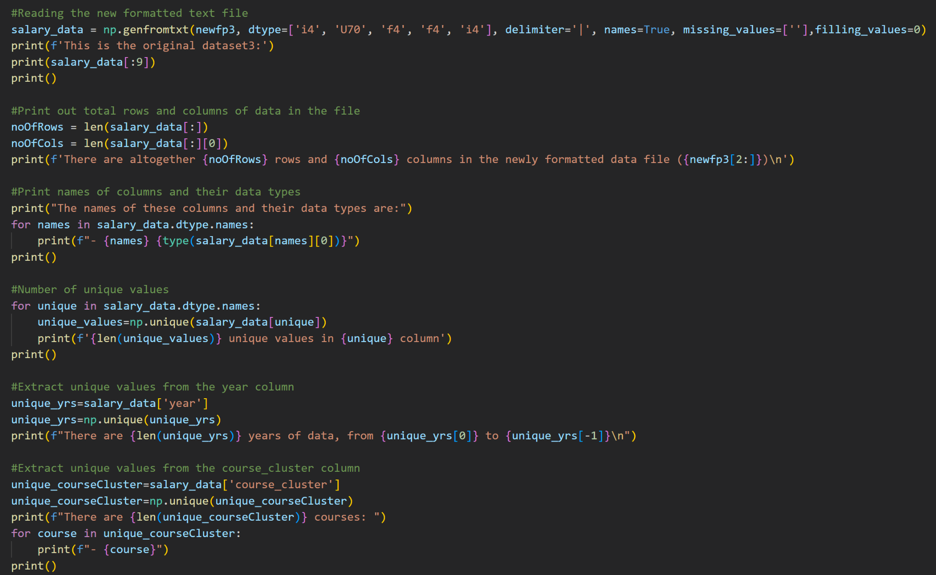
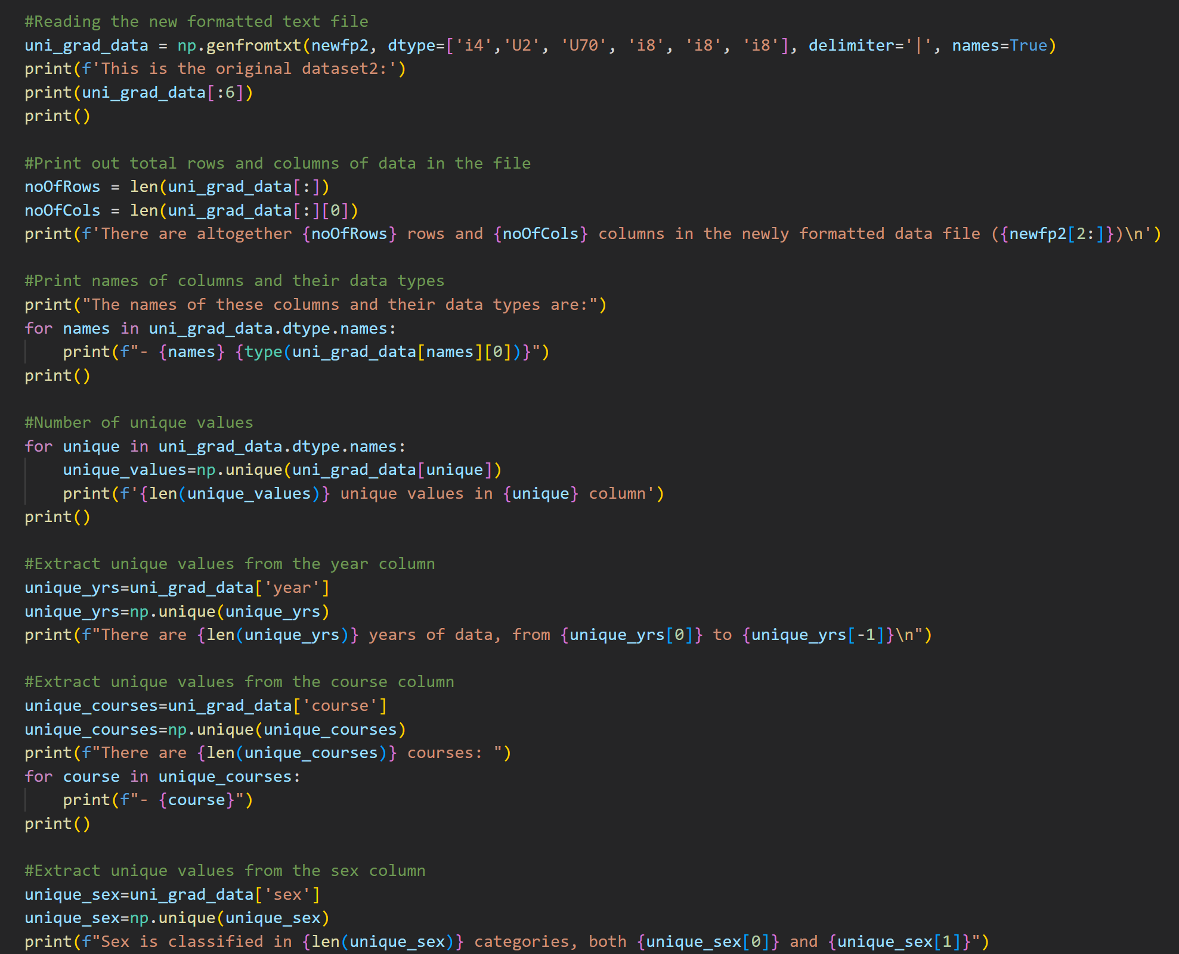
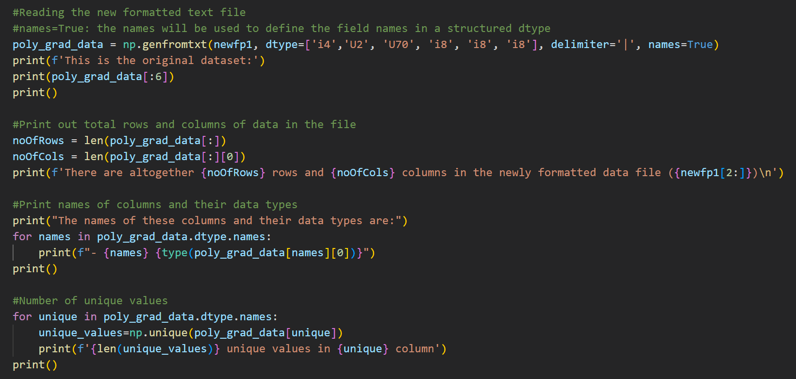
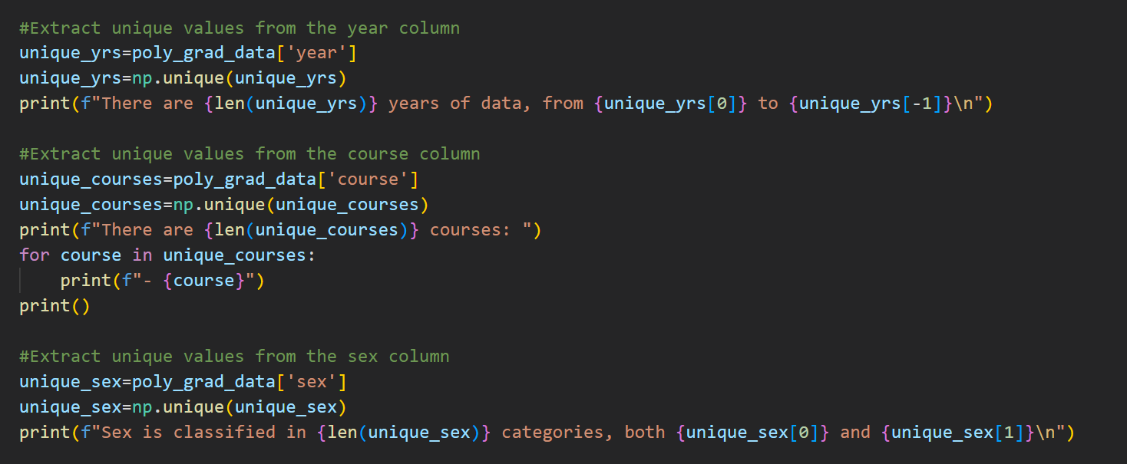
print(datasets_Nature)

Slide 7
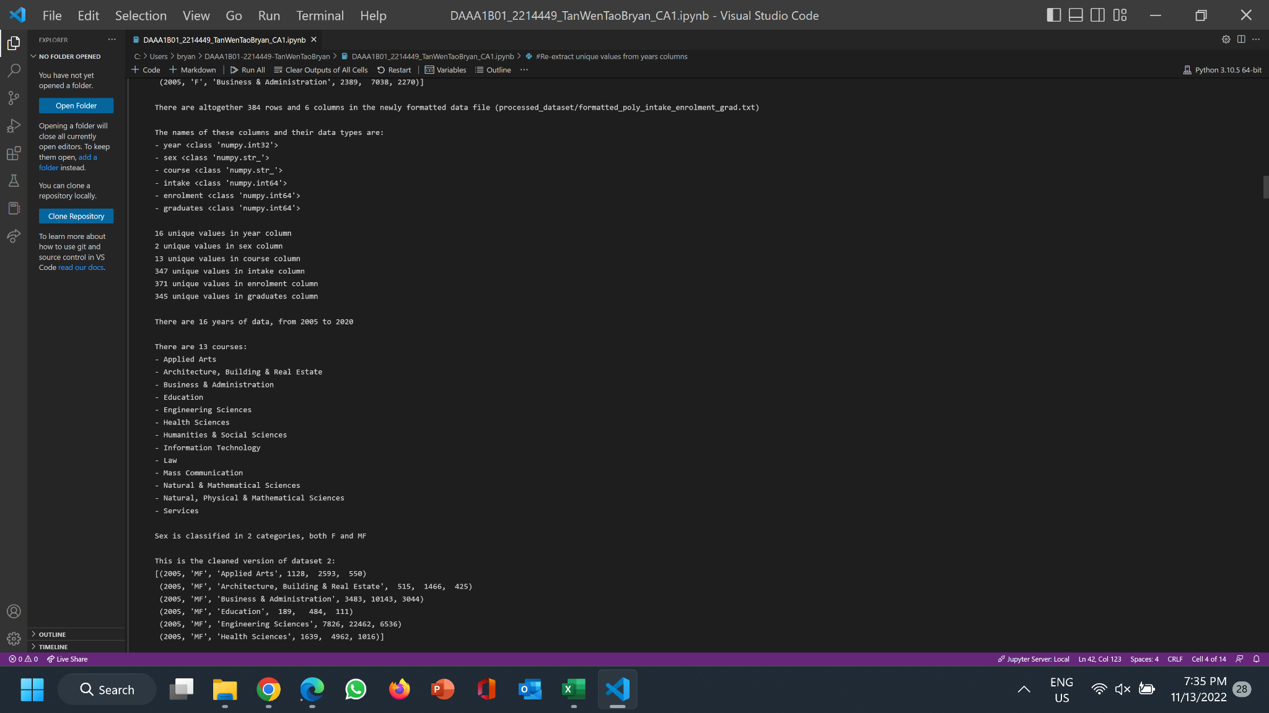
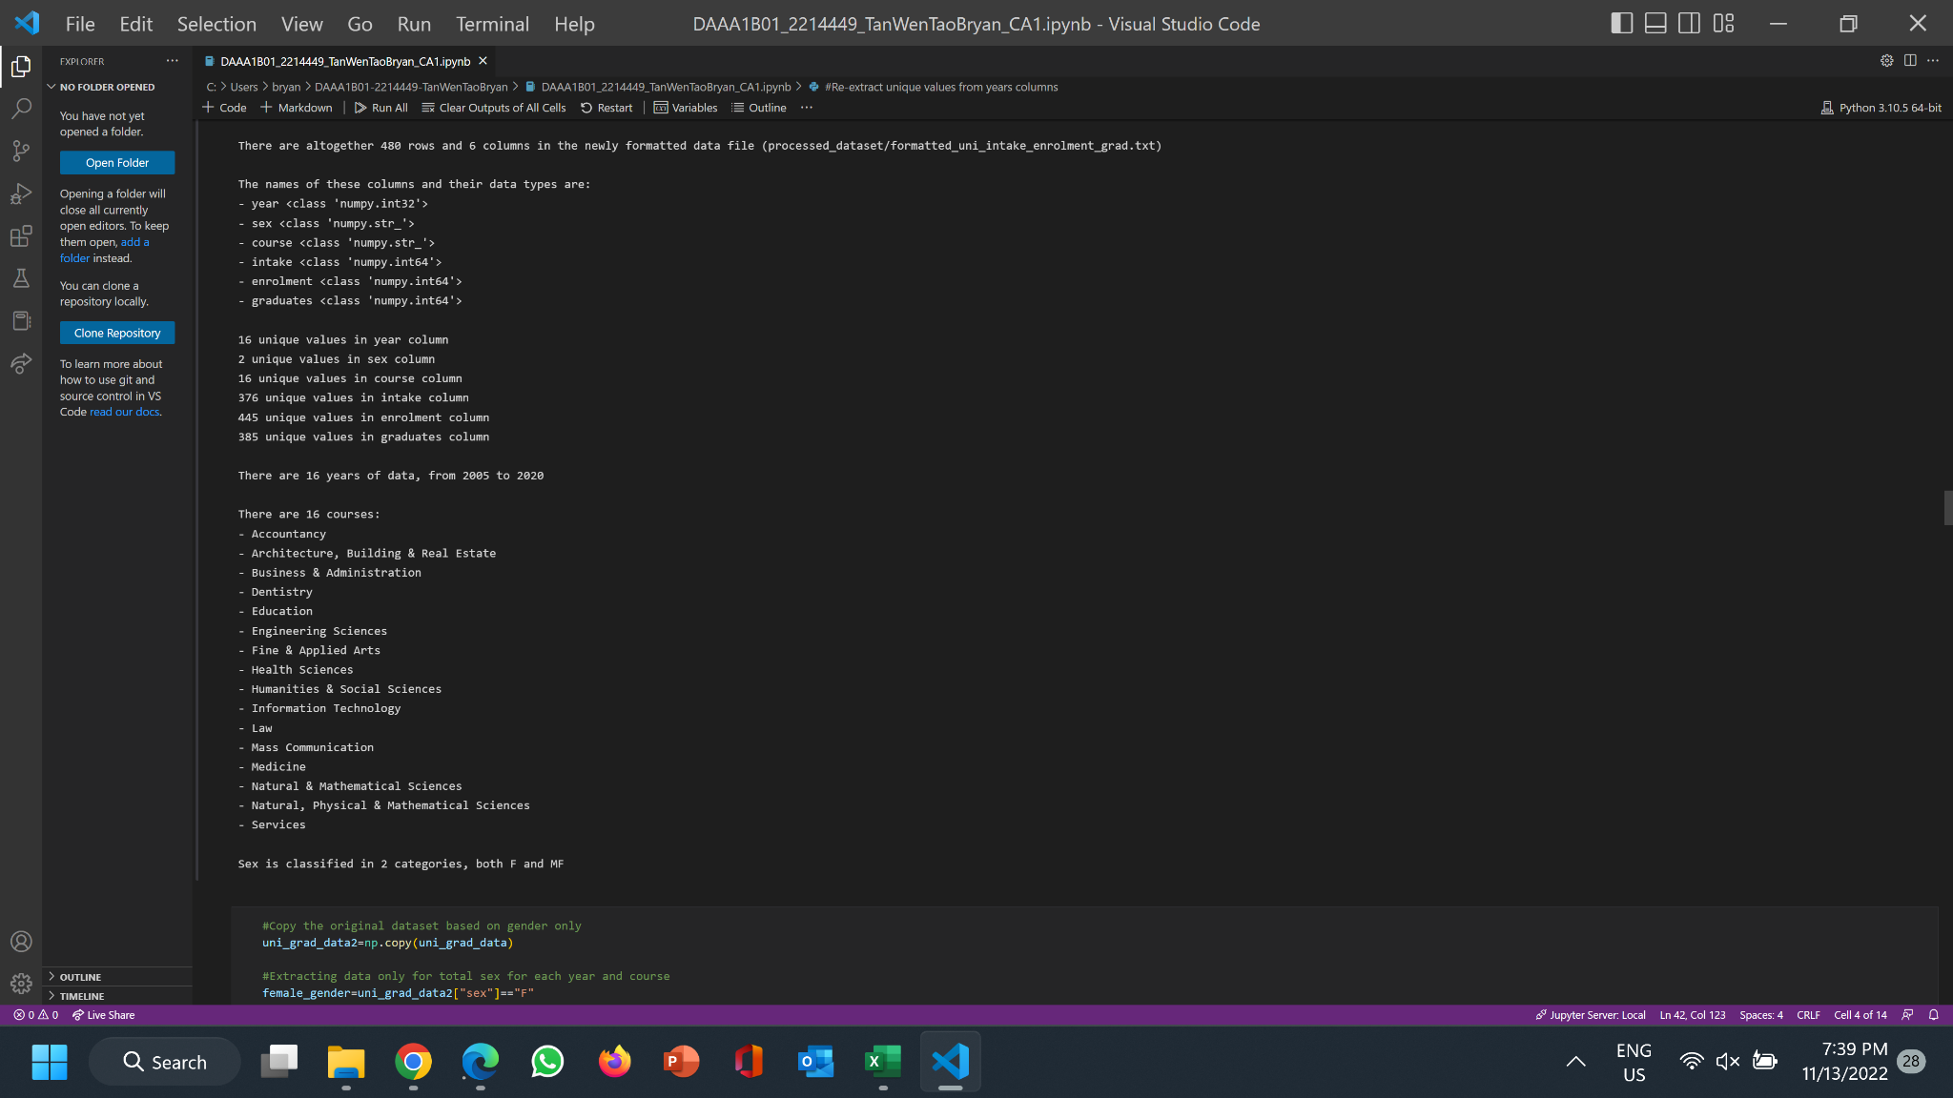
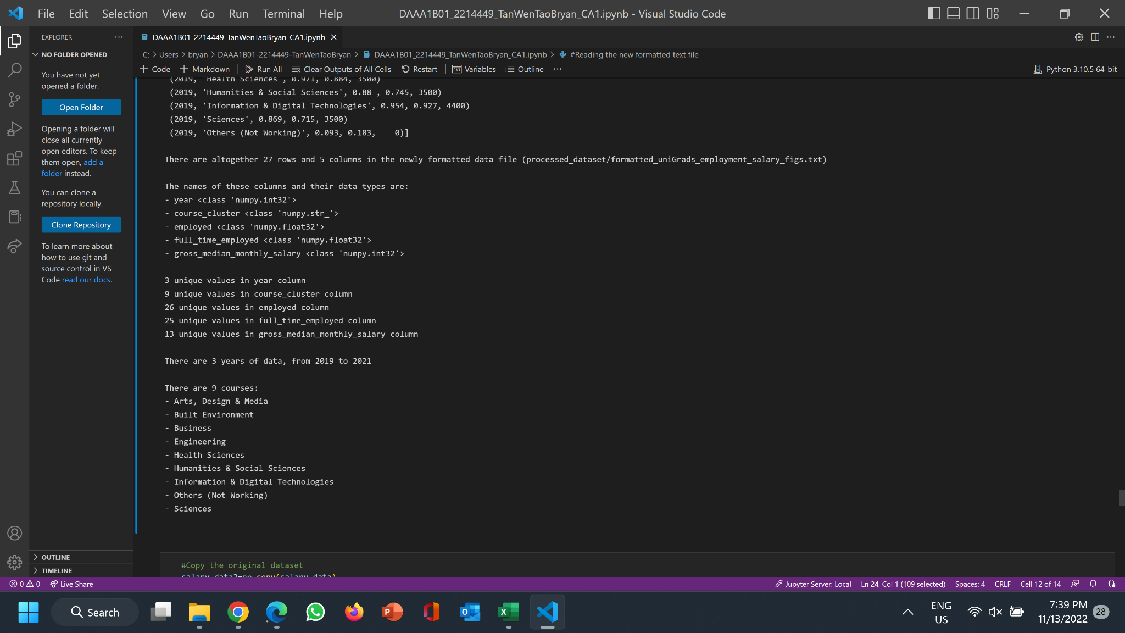
print(datasets_Nature)
Dataset 1: Polytechnic Intake, Enrolment & Graduates by Course
Dataset 2: University Intake, Enrolment & Graduates by Course
Dataset 3: Fresh University Graduates Gross Median Monthly Salary

Slide 8
03
Data Cleaning

Slide 9
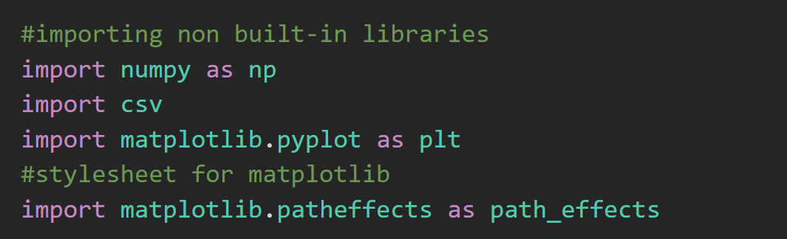
initialize(libraries)

Slide 10
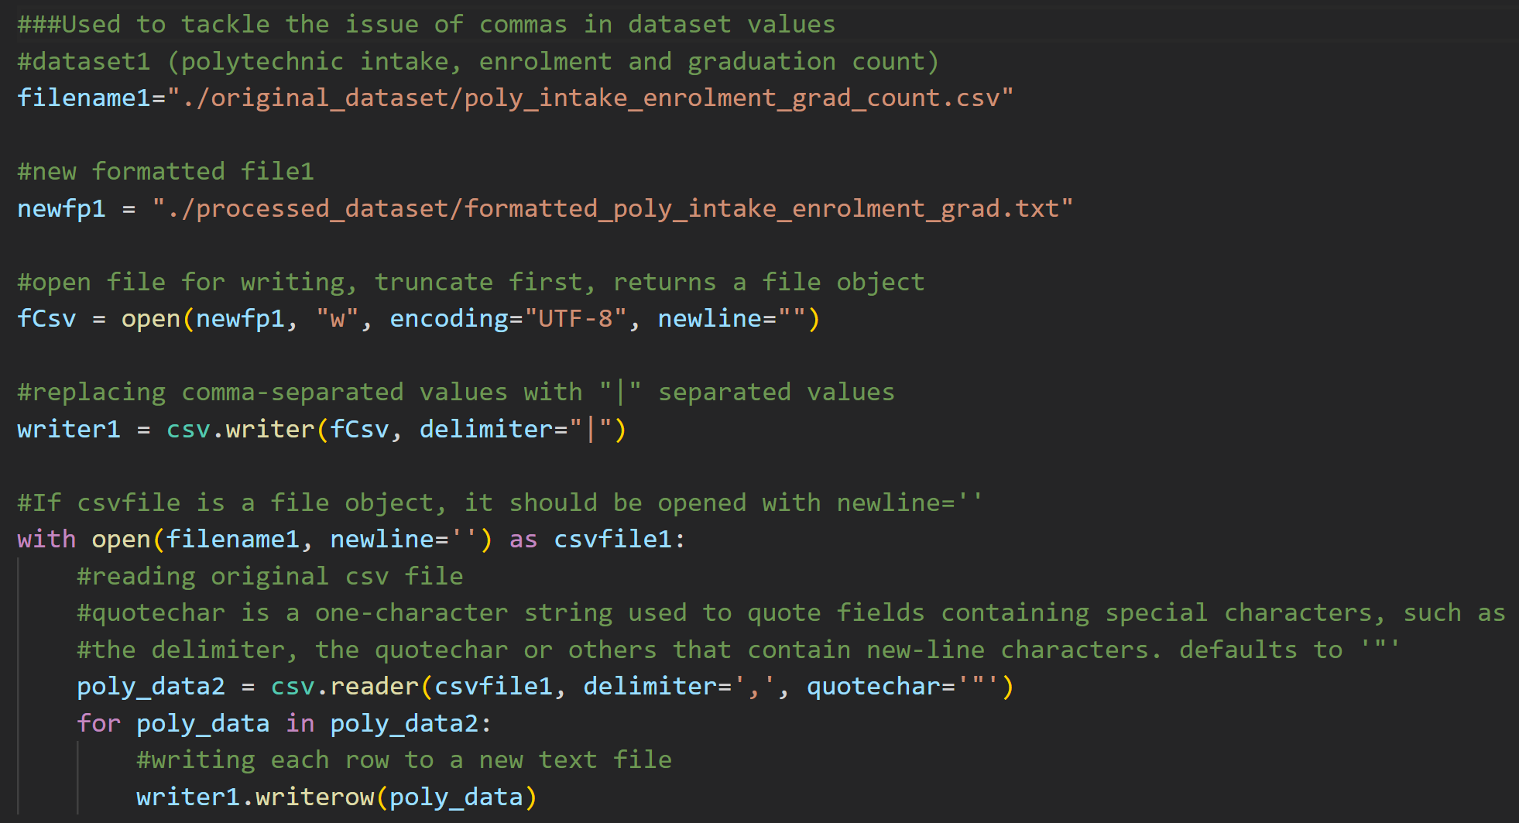
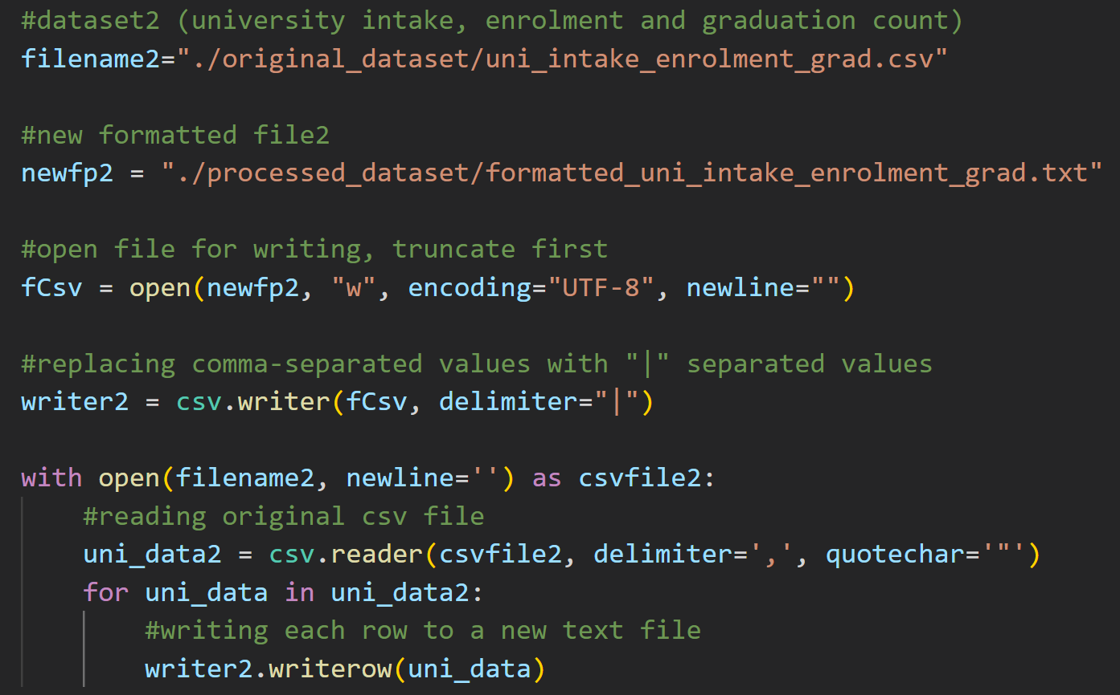
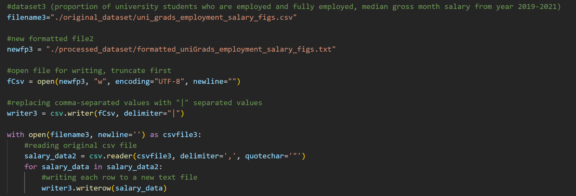
process(data)
Mainly replace delimiter with a symbol “|” other than a “,”
Open the original file, read the data, replace the delimiter with “|”, then write back each row into a new file

Slide 11
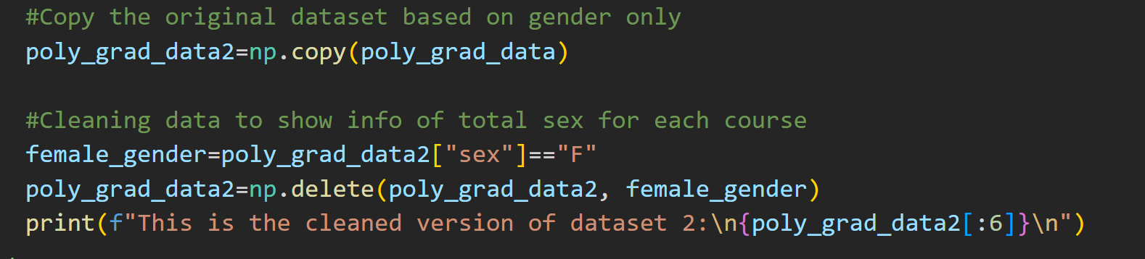
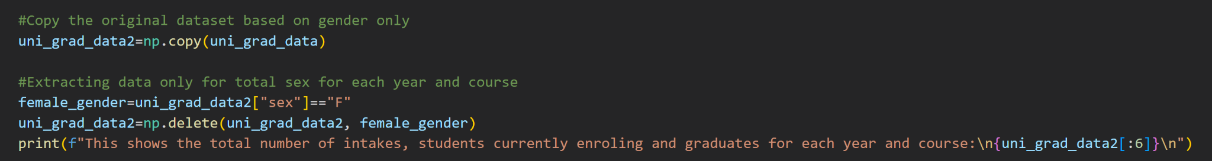
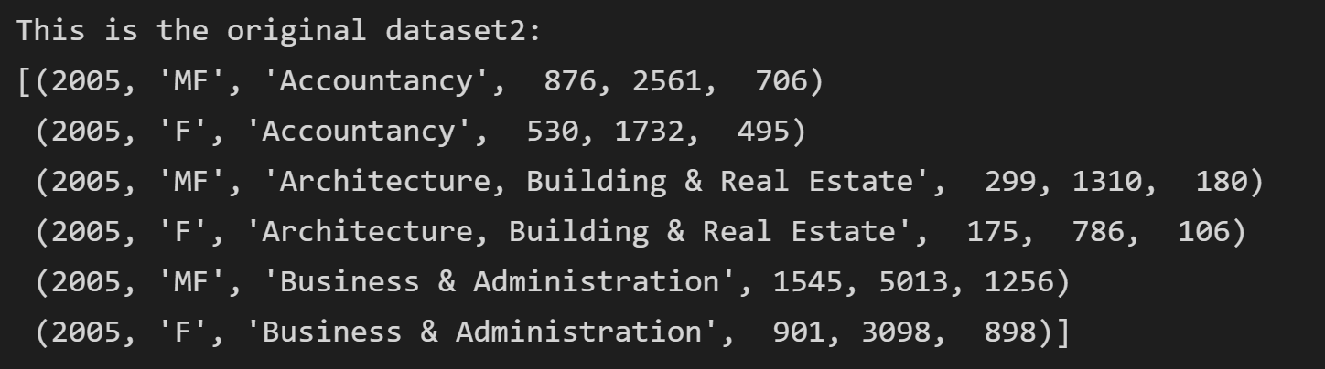
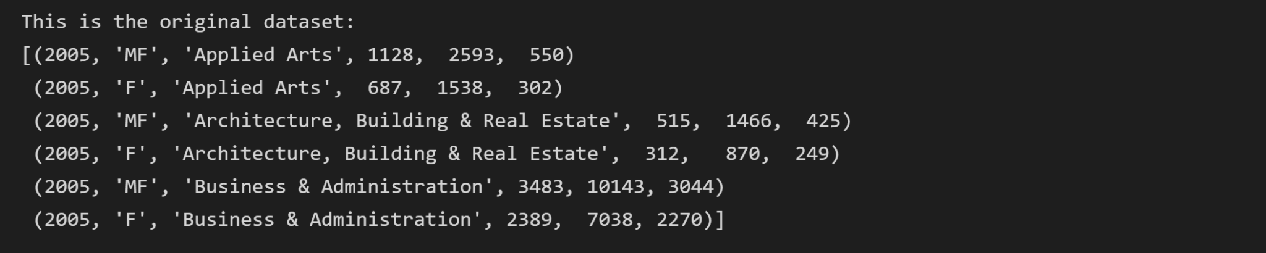
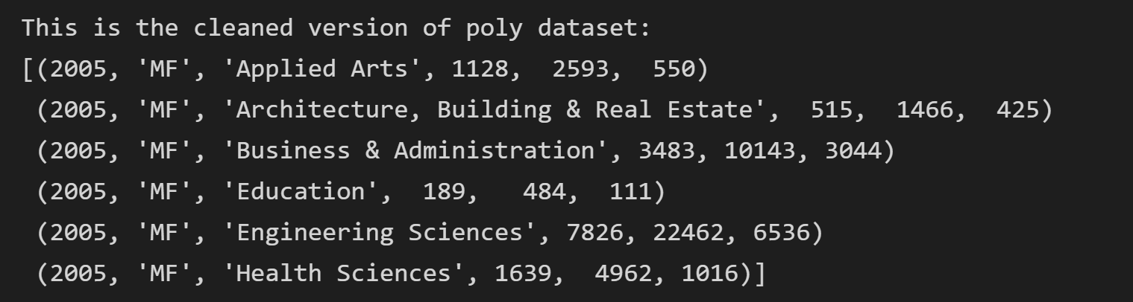
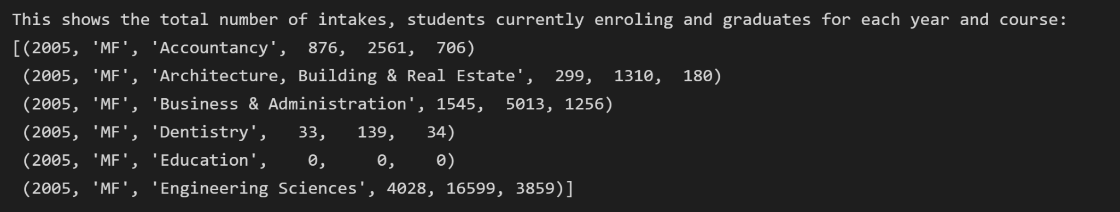
process(data)
Original Dataset:
Copy the dataset so changes made will not affect original dataset
Use Boolean Indexing to extract the rows of data that matches “F” in sex column
Delete those rows of data.
Used for both dataset1 and dataset2.
Original Dataset:
Cleaned Dataset:
Cleaned Dataset:

Slide 12
04
Graphs

Slide 13
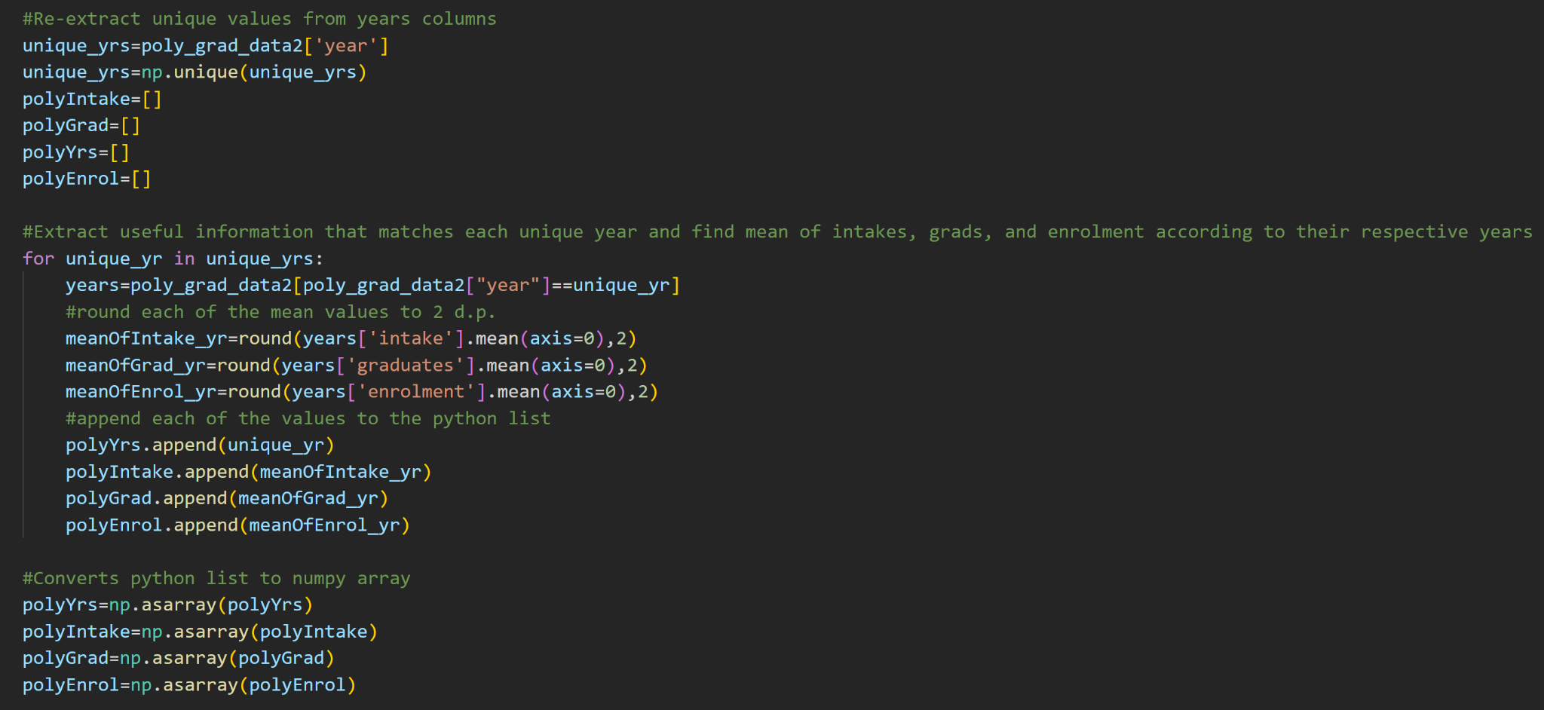
np.process(dataset1)

Slide 14
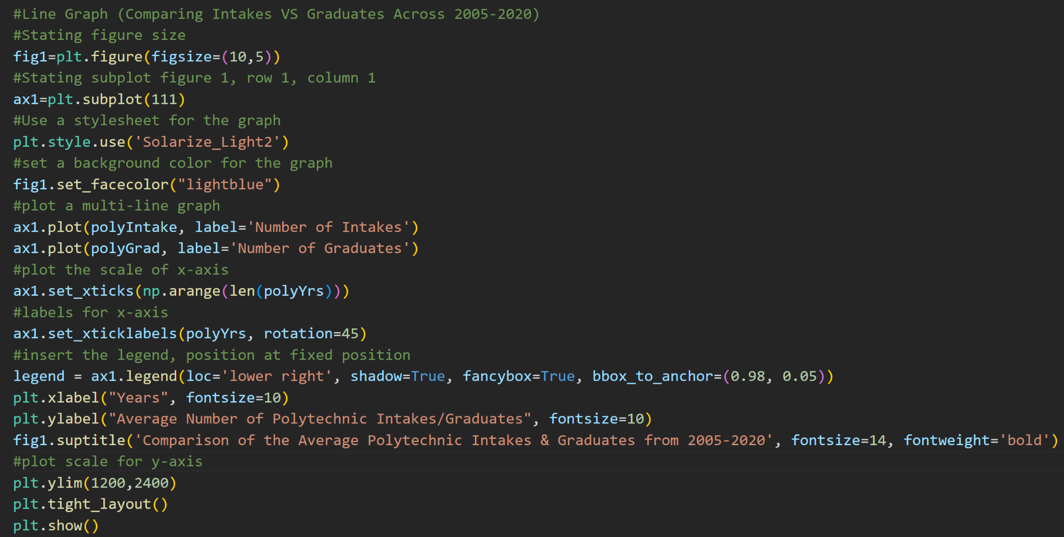
plt.show(graph1)

Slide 15
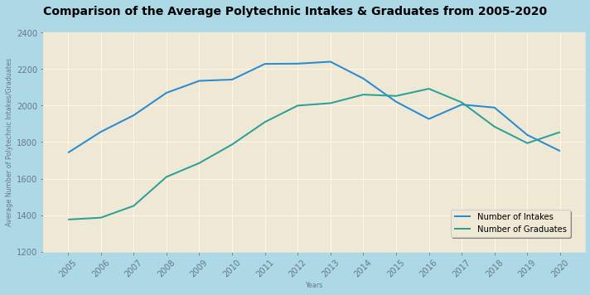
plt.show(graph1)
1) Generally, there is an increasing trend of number of graduates over the years while the number of intakes remain stagnant, with a surge of increase from 2005-2013 and a decreasing anomaly which happened from 2013-2016 over the years.
2) Since the years taken to graduate polytechnic is approximately 3-4 years, the number of graduates 3 years after the number of intakes is being directly affected. Ex. 2016 had highest number of intakes, 3 years later, 2016 had highest number of graduates. 2013-2016 had a decrease in intakes, 2016-2019 also had decrease in graduates.
3) There is approximately the same number of polytechnic intakes and graduates in 2017.

Slide 16
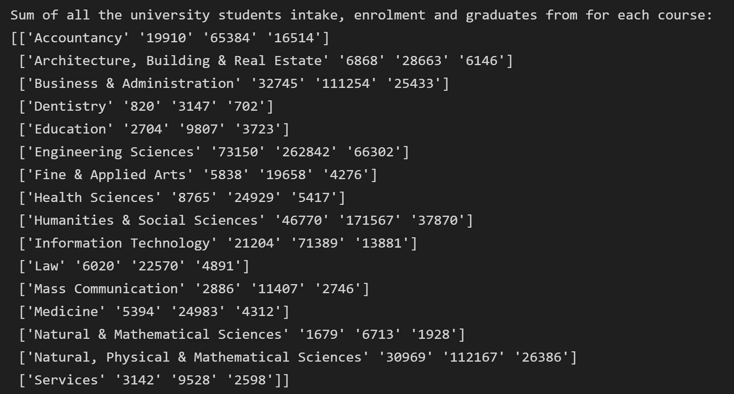
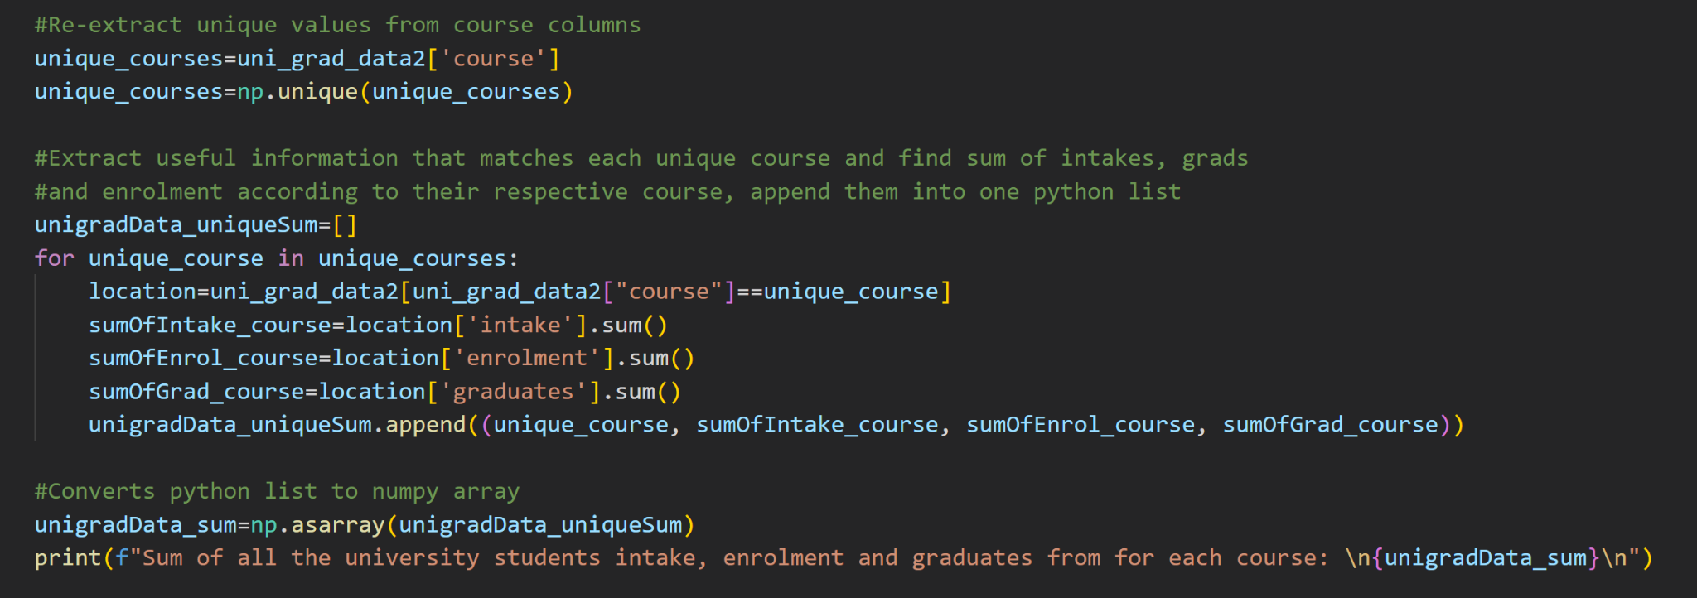
np.process(dataset2)

Slide 17
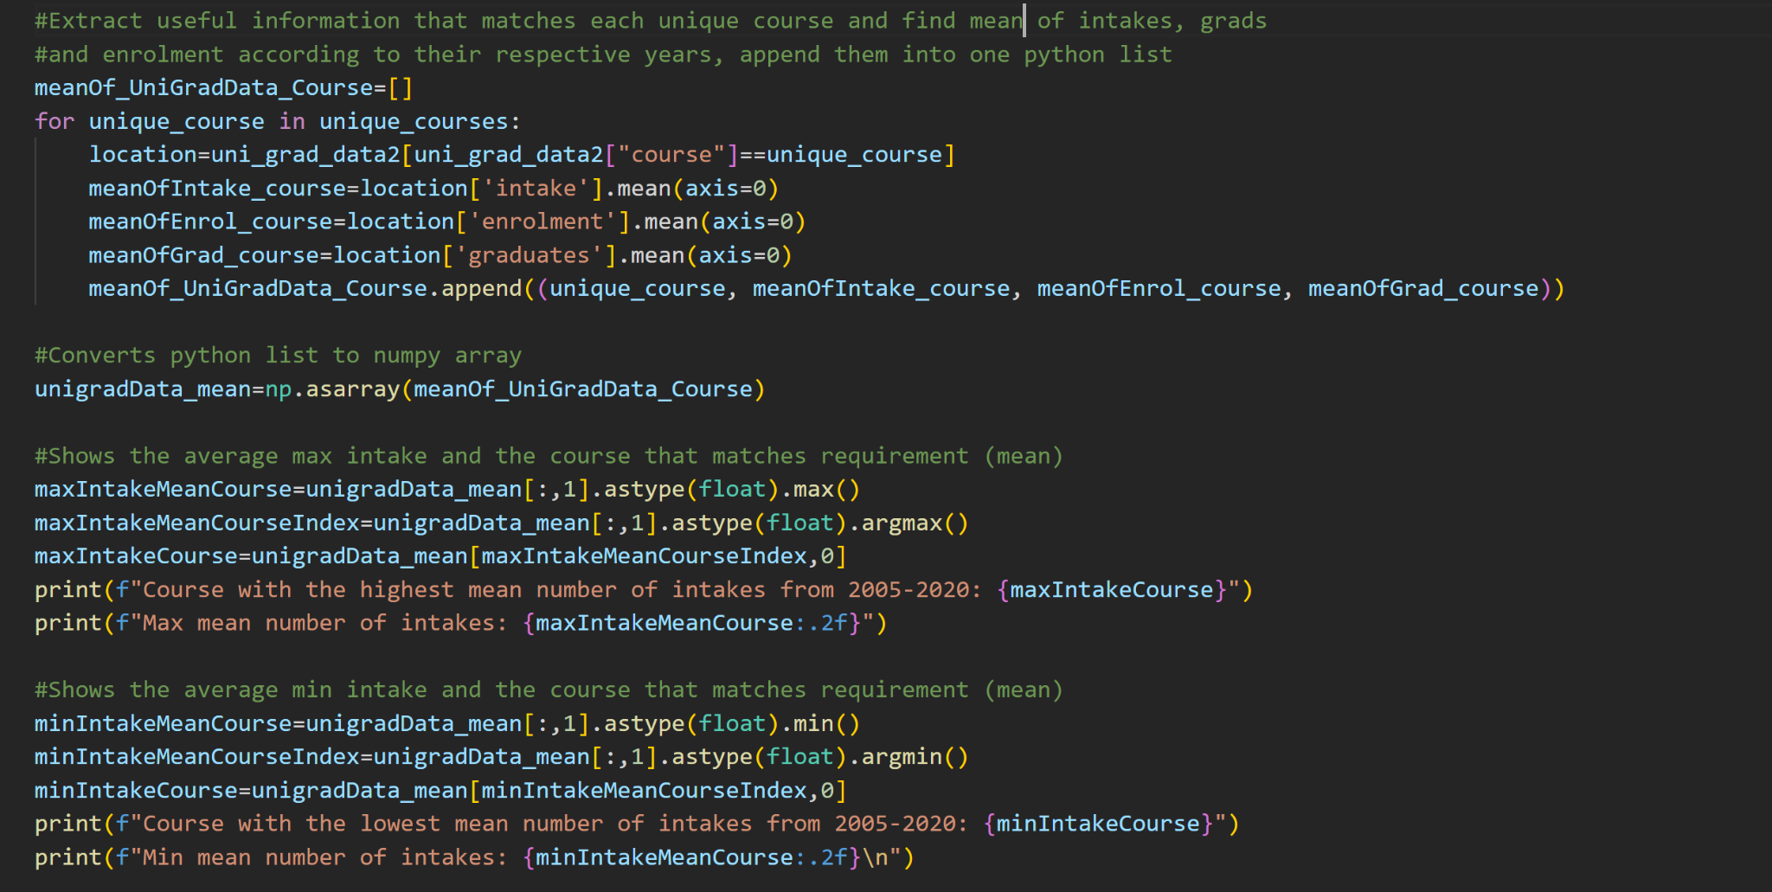
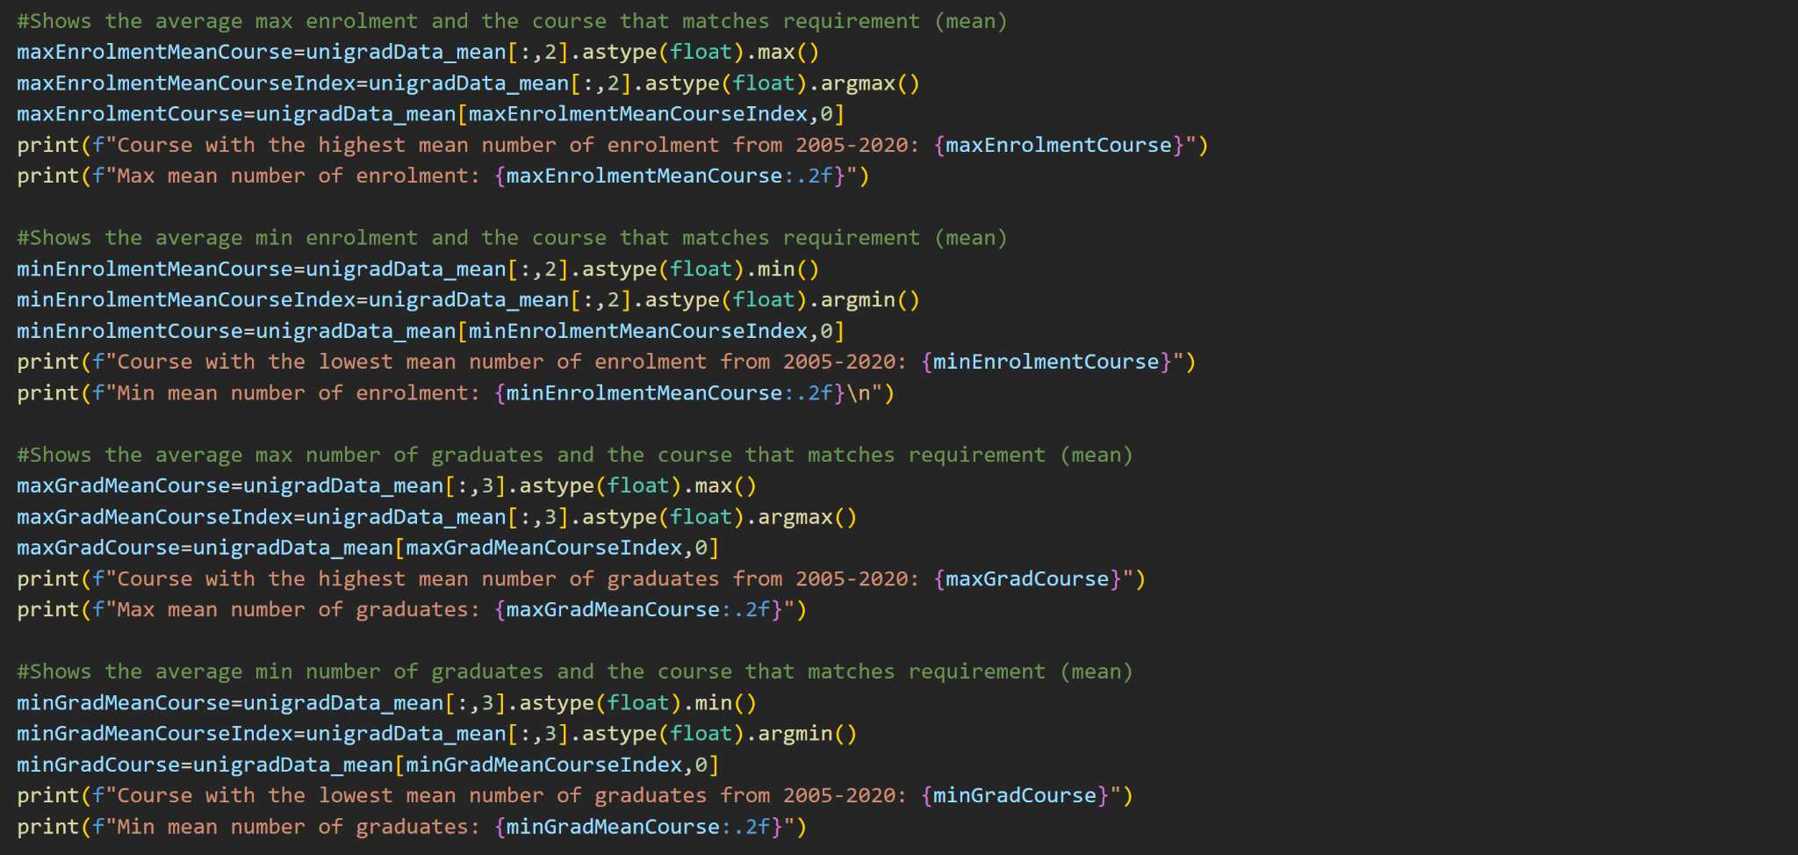
np.process(dataset2)
*Animated Objects in slides

Slide 18
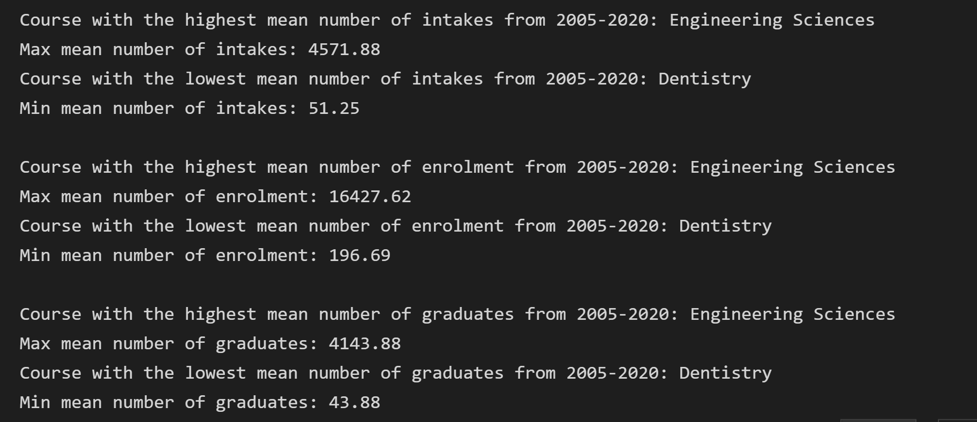
np.process(dataset2)
1) Engineering Sciences has the most number of intake, enrolment and graduates while Dentistry has the fewest intake, enrolment and graduates over the years. (Further supported by graph on slide 20)

Slide 19
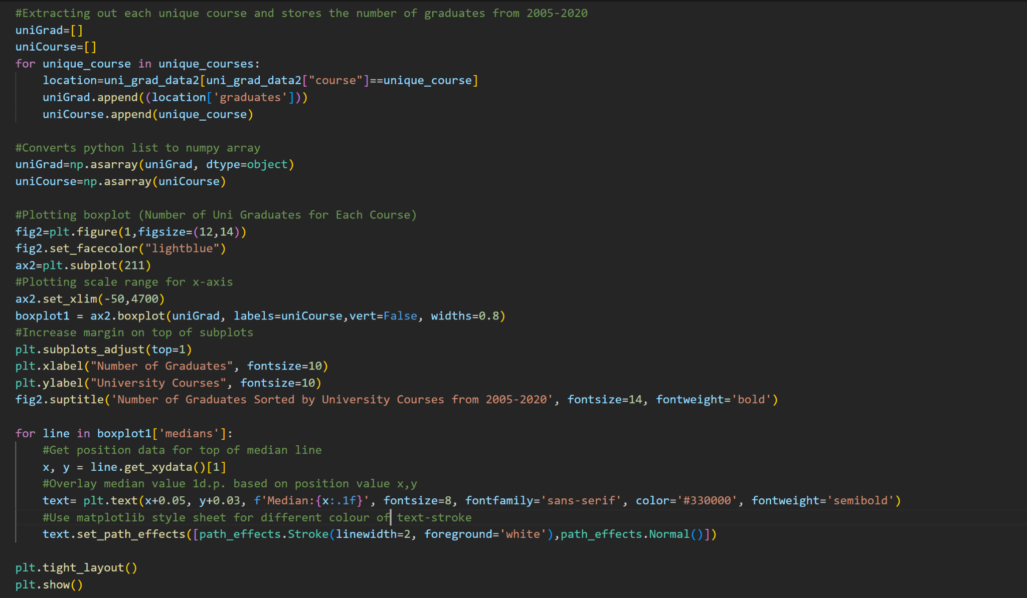
plt.show(graph2)

Slide 20
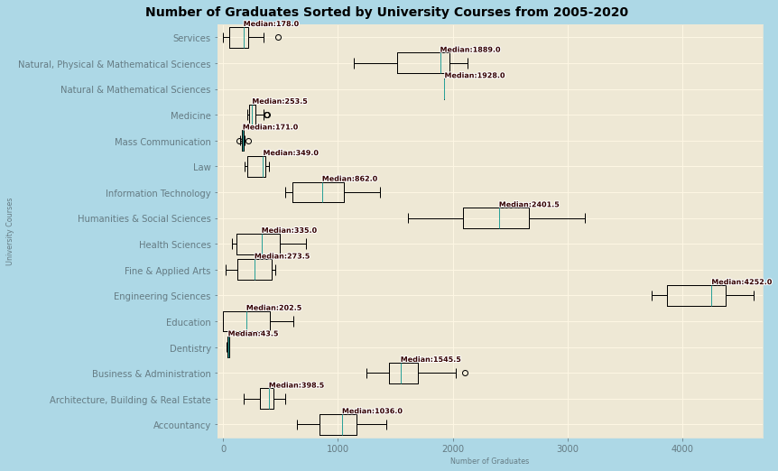
plt.show(graph2)
1) Engineering Sciences has more graduates than any other courses while Dentistry has the fewest graduates over the years. (Further supported by numpy analysis in slide 17,21)
2) Number of graduates over the years in Humanities and Social Sciences is the most varied, least consistent while number of graduates over the years in Natural & Mathematical Sciences is the most consistent (nearly zero, as seen in slide 22)

Slide 21
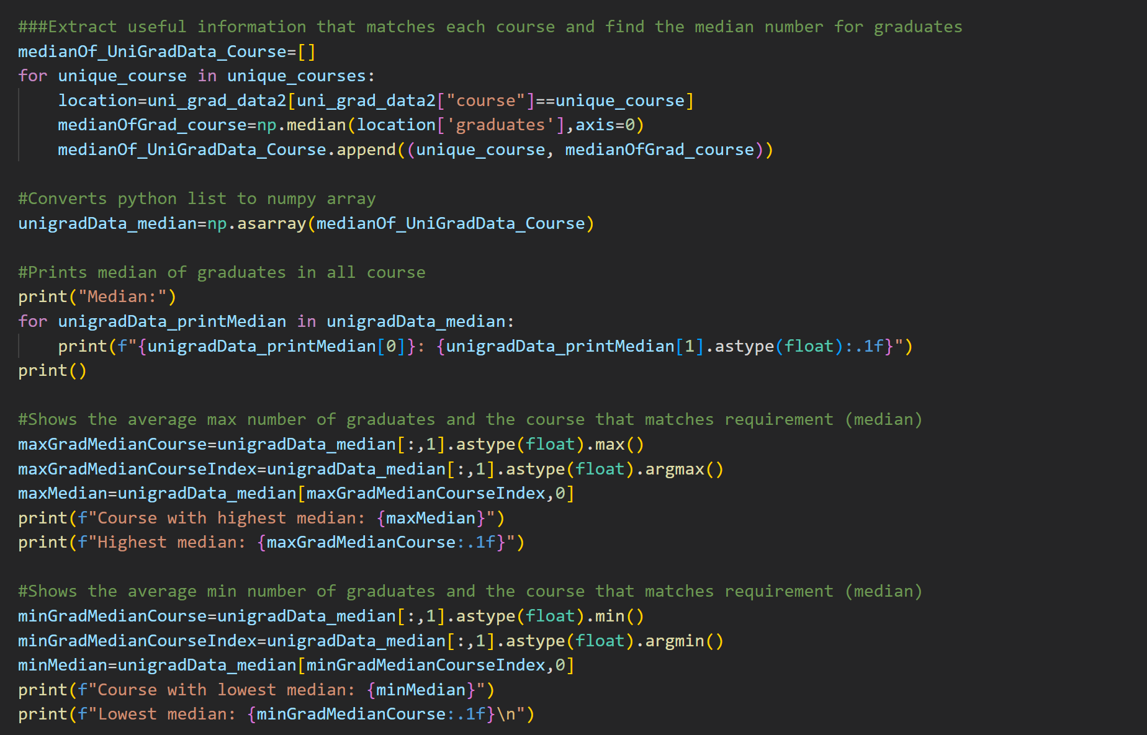
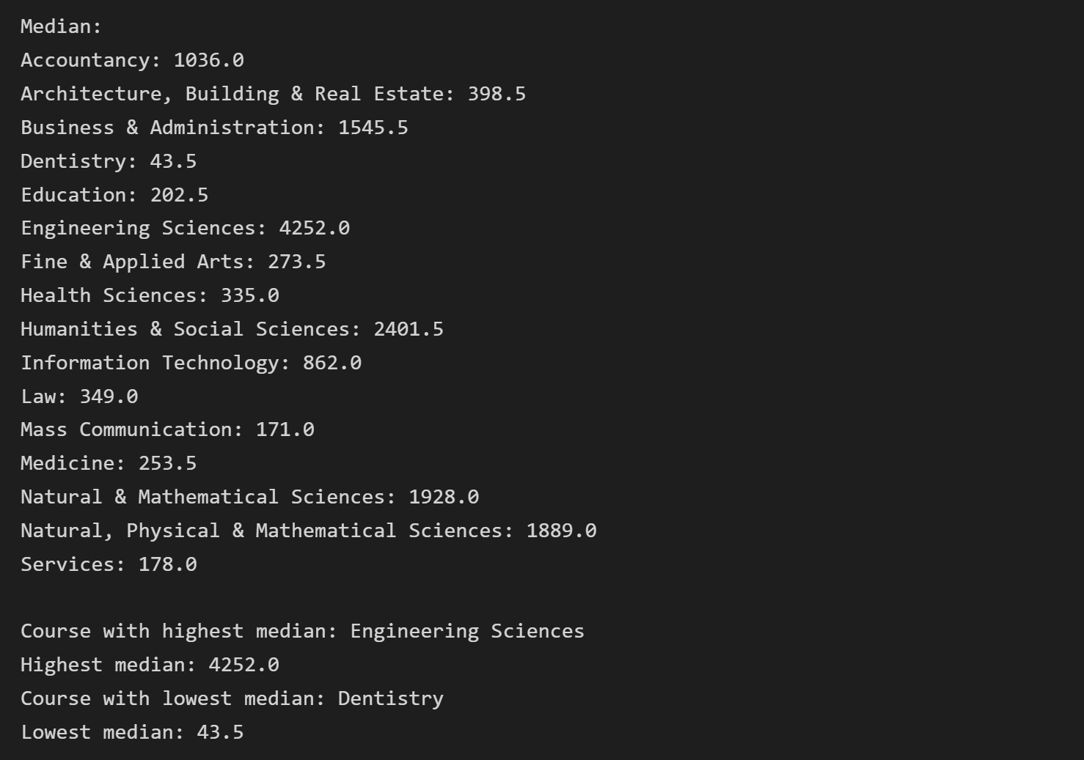
np.process(dataset2)

Slide 22
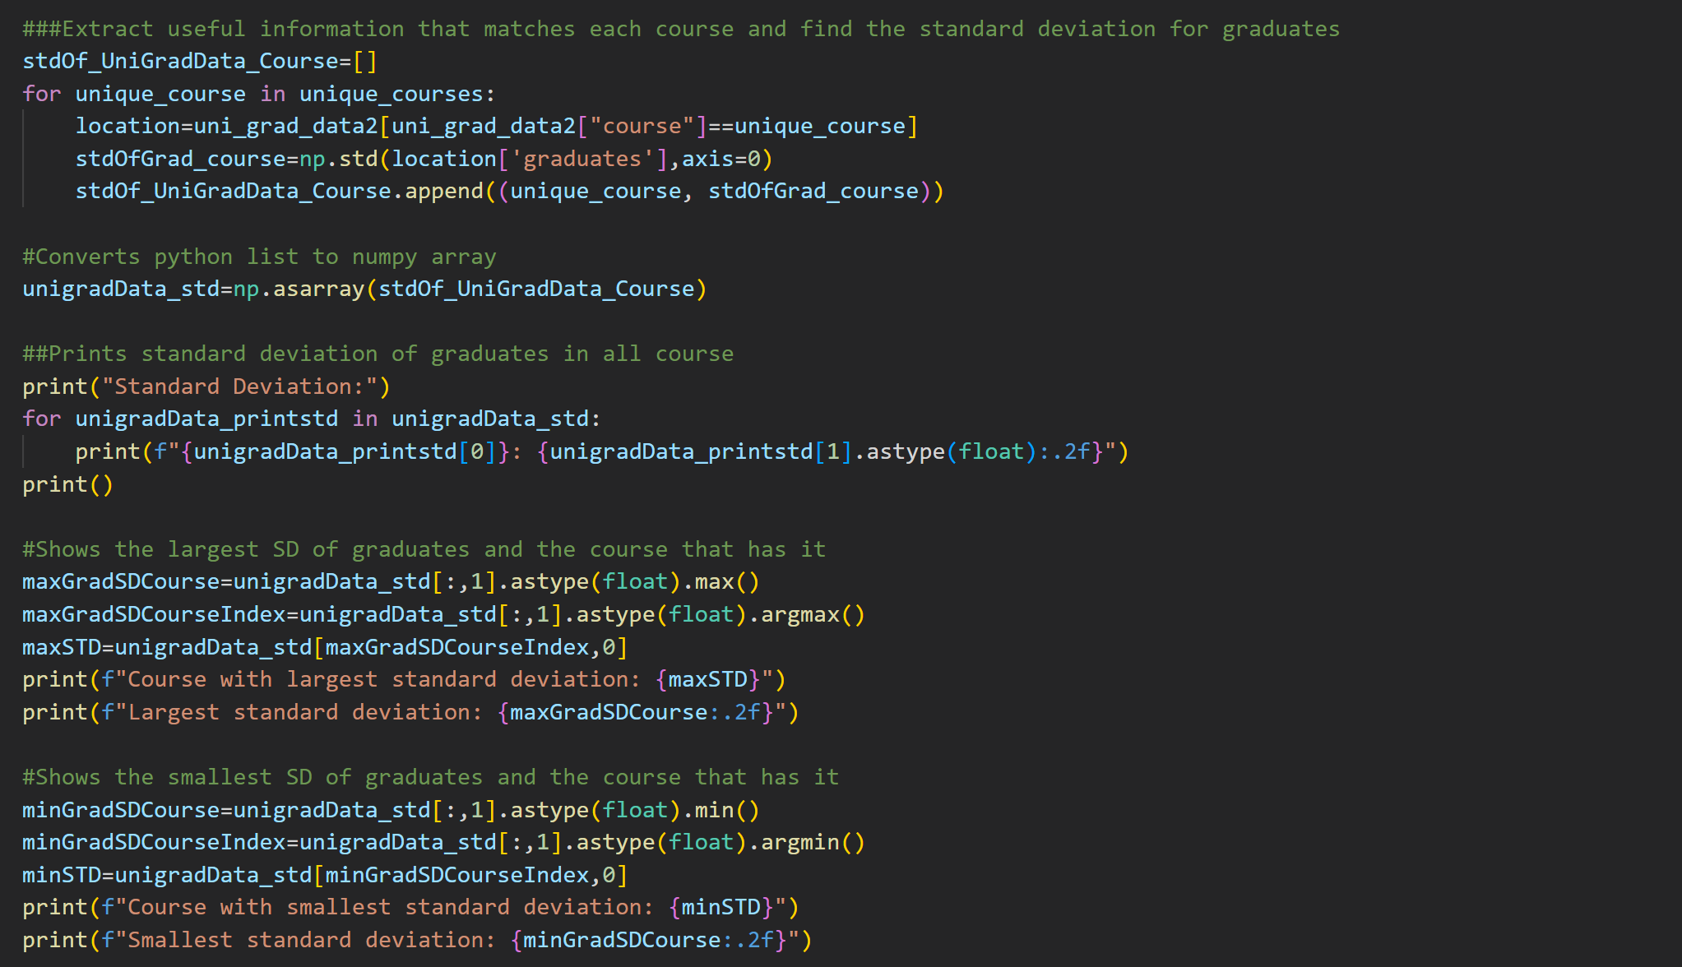
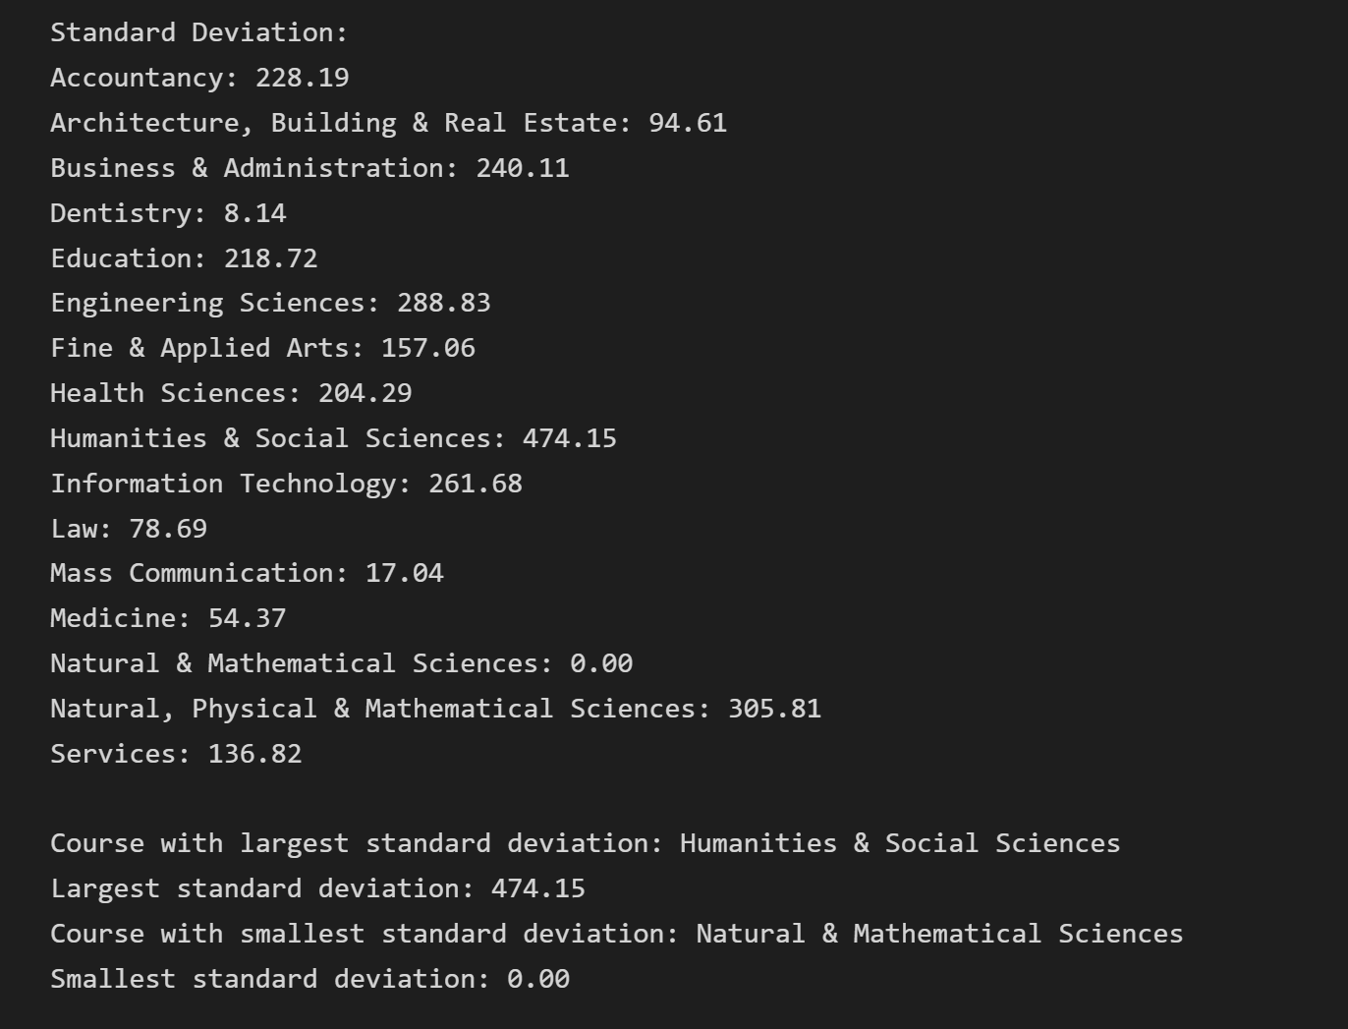
np.process(dataset2)

Slide 23
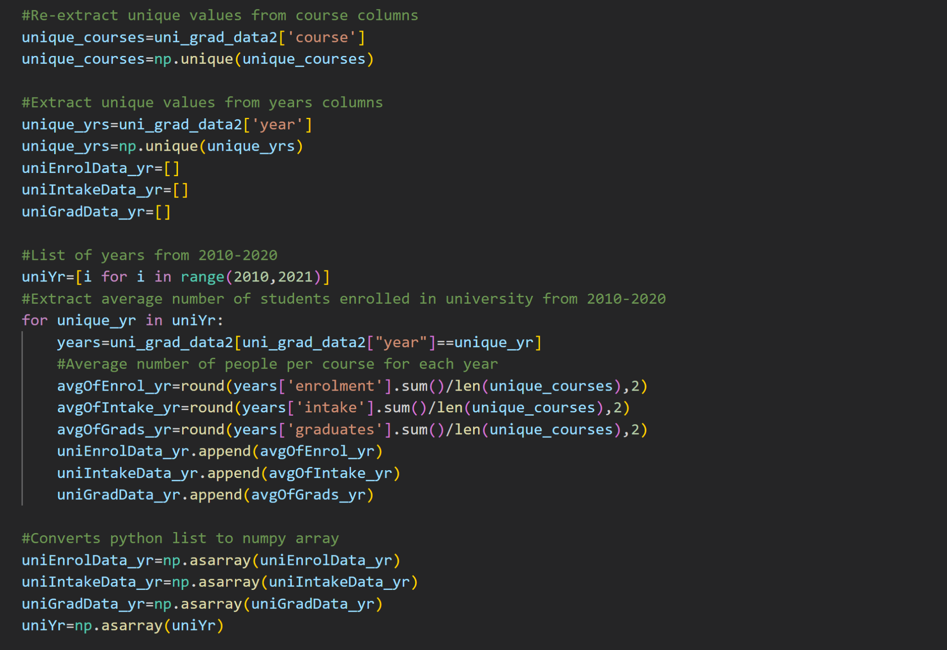
np.process(dataset2)

Slide 24
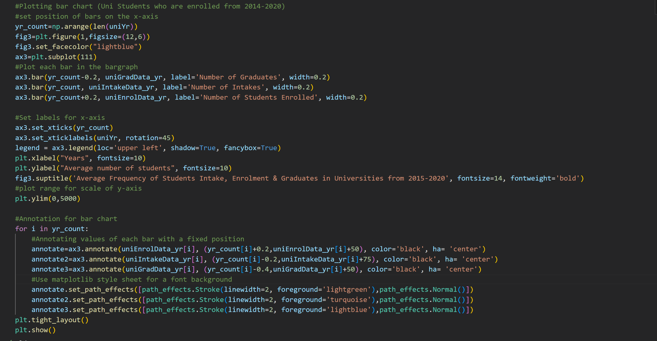
plt.show(graph3)

Slide 25
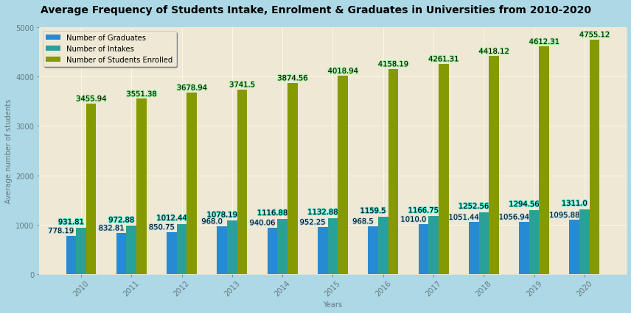
plt.show(graph3)
1) Average number of graduates over the years is the lower than average number of intakes and students enrolled.
2) Most number of intakes, enrolment and graduates in 2020, and least number of intakes, enrolment and graduates in 2010.
Different than polytechnic intakes and graduates as there is a consistent increase (no sudden decrease)
Reason: Might be due to the number of years needed to graduate, which allow enrolment number to accumulate, resulting in a delayed increase to number of graduates

Slide 26
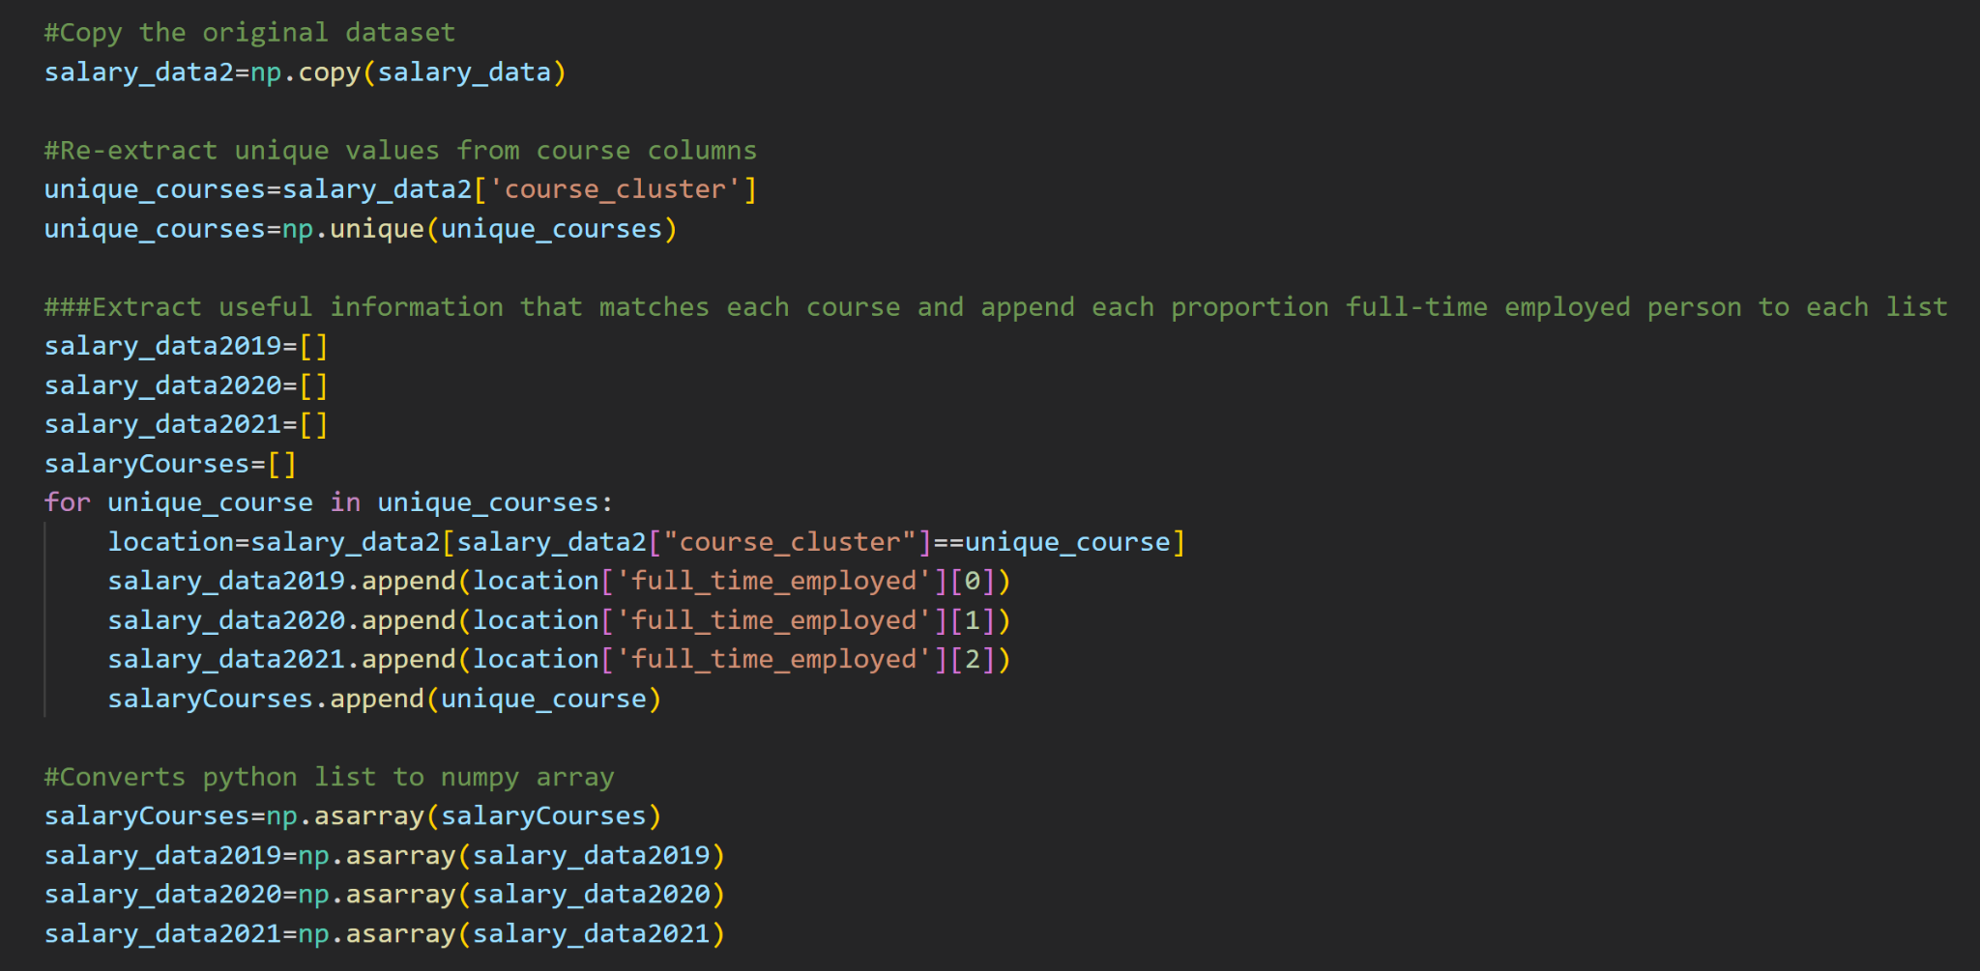
np.process(dataset3)

Slide 27
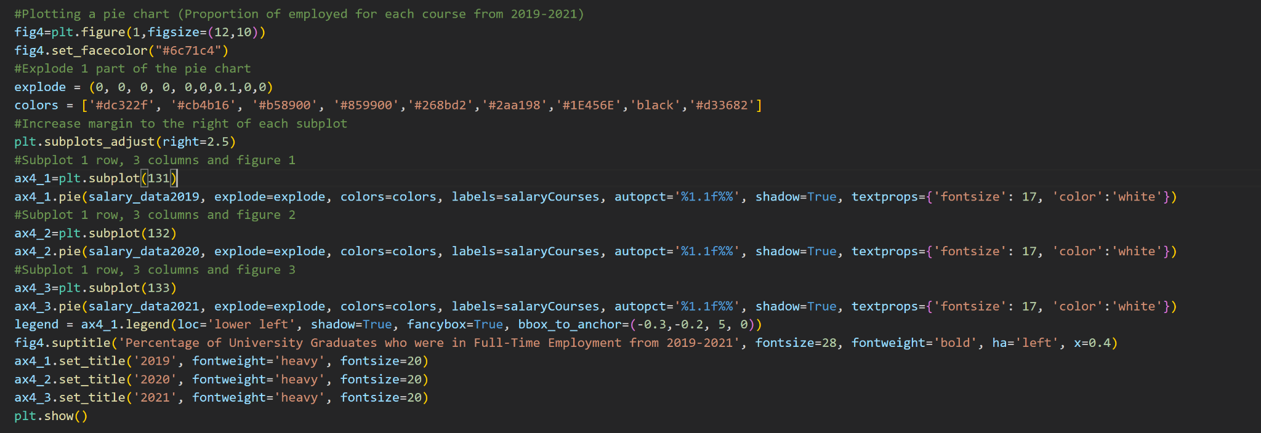
plt.show(graph4)

Slide 28
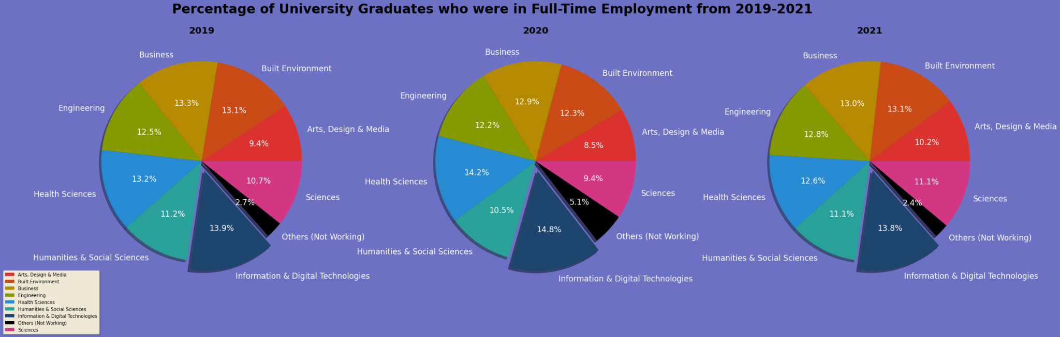
plt.show(graph4)
After excluding the people who were not in full time employment, Arts, Design & Media has the smallest proportion of university graduates who were in full-time employment at 9.4%, 8.5% and 10.2% respectively.
For 2019-2021, Information & Digital Technologies has the largest proportion of university graduates who were in full time employment at 13.9%, 14.8% and 13.8% respectively. 2020 has more university graduates working full time than 2019, it is probably because of COVID 19 pandemic, causing people to rely on digital technologies more frequently, increasing the demand for IT people for work.

Slide 29
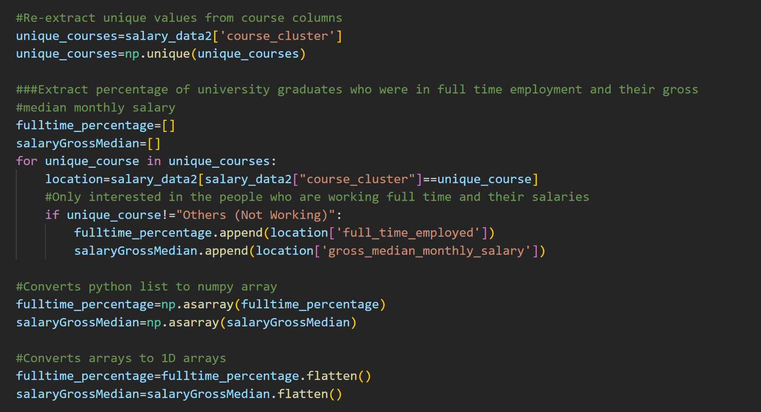
np.process(dataset3)

Slide 30
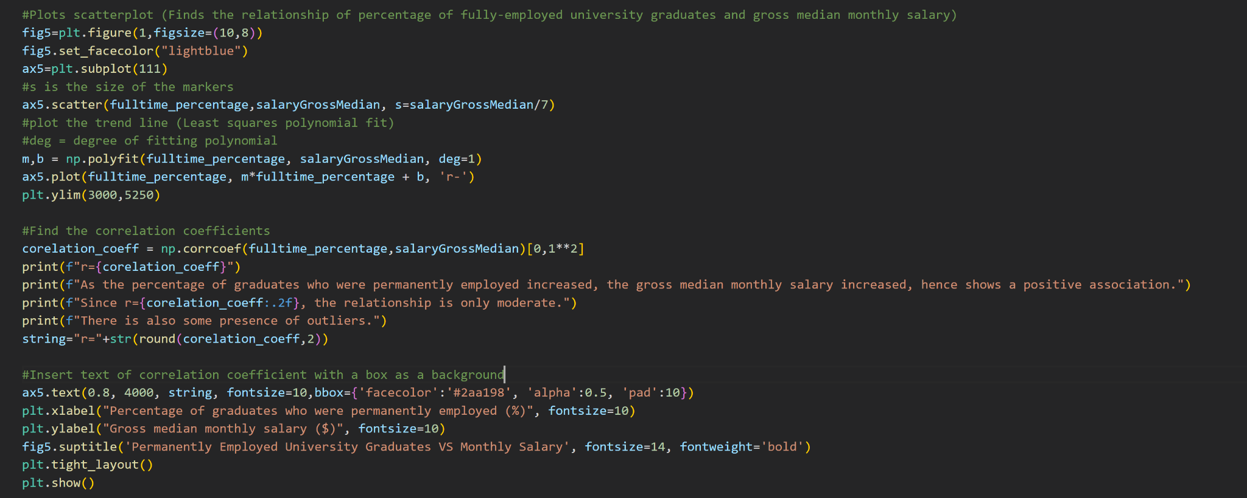
plt.show(graph5)

Slide 31
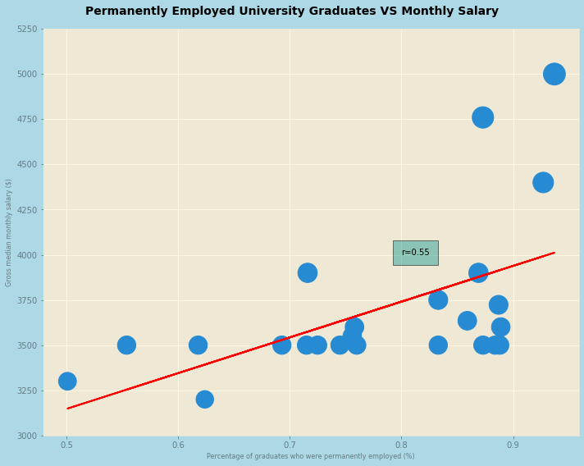
plt.show(graph5)
1) As the percentage of graduates who were permanently employed increased, the gross median monthly salary increased. This shows a positive, linear relationship between the two variables.
2) Since r=0.55, the relationship is only moderately positive.
3) There is presence of a few outliers, those outliers are the graduates who were from the Information & Digital Technologies Sector. Since there were higher demand of IT people during 2019-2021 as seen in the pie chart previously, there was also a higher gross median salary as a result.

Slide 32
05
Conclusion and Suggestions

Slide 33
conclude(dataset)
For Polytechnic, the number of intakes is directly related to the number of graduates.
For Universities, Engineering Sciences has the HIGHEST number of graduates, whereas Dentistry has the LOWEST of graduates over the years 2005-2020.
Humanities and Social Sciences has the MOST VARIED number of graduates, while Natural & Mathematical Sciences has the MOST CONSISTENT number of graduates over the year 2005-2020.
Change of frequency for university graduates and intake and polytechnic graduates and intake is very different as the number of years to graduate is different.
For Universities, as the years increased, the number of graduates increased, due to the accumulation of intakes that took place from previous years.
IT and Digital Technologies sector has the highest demand of graduates working permanently in 2020.
As the percentage of graduates who were permanently employed increased, the gross median monthly salary increased.

Slide 34
recommendations.py
Universities should promote the dentistry course to college graduates or secondary school students more through events or social media to appease to more students to join, which can increase the number of intake and possibly increase the number of graduates in the future.
Students who are planning to join polytechnic and university and wish to earn a high salary can consider joining IT and digital technology sector, which will definitely bring them to their goal.
Organisations can host more social events during holidays for people working in arts, design and media sector to work at, increasing the gross median salary.

Slide 35
THANK YOU!
input(“Do you have any questions?”)

